Slide 1

I N V I S I B L E E XO S K E L E T O N F O R
SETHU INSTITUTE OF TECHNOLOGY PULLOOR,KARIAPATTI
P E R F E C T P E R C H
TEAM MEMBERS:
1. HASMITHA.M.N -2020111023
2. ALAN JUDA ELROY. T-2020111007
3. MEERASRI.K.S -2020111032
4. NAGA SUVEATHA.N -2020111037
MENTOR: Dr.E.MAHESWARAN AP(SG)/BME

Slide 2
ABSTRACT
When standing occurs continually over prolonged periods, it can result in inflammation of the veins.This inflammation may progress over time to chronic and painful varicose veins.
So this device will be made in a way that it will be attached on the back of our bending posture of legs.
It is attached in the way that the position is comfy while sitting without a chair. It just gives the balanced position for body to sit. To reduce the problems related to leg pain.
The main objective of our idea it to sit whenever you feel tired.

Slide 3
INTRODUCTION
Prolonged standing effectively reduces the blood supply to the muscles resulting in the acceleration of the onset of fatigue and causes pain in the muscles. Therefore, we designed the contraption that is secured with belts at the hips and another pair of straps binds it securely to the legs. Here, a general concept of the human- exoskeleton compatibility and interaction control is addressed. To overcome decline of their activity leads to strengthen the humans in the future.

Slide 4
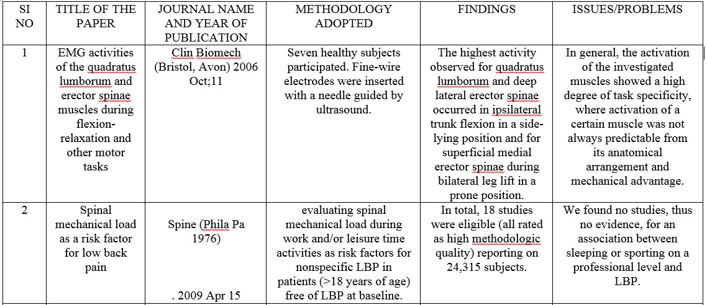
LITERATURE REVIEW MATRIX

Slide 5
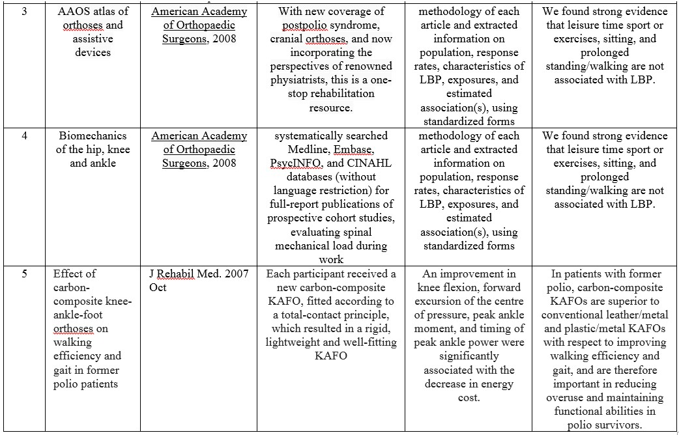

Slide 6
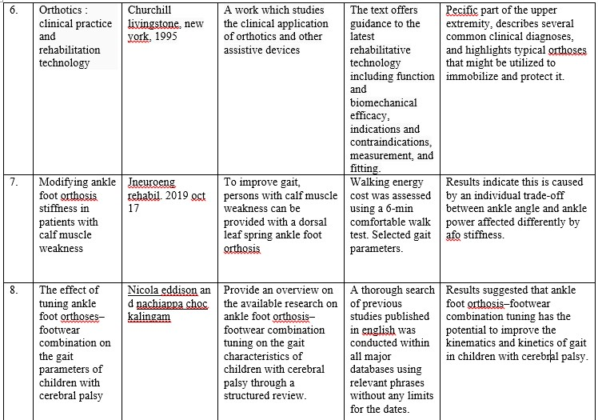

Slide 7
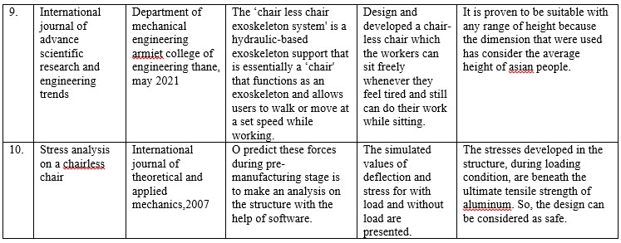

Slide 8
SOCIAL RELEVANCE
Compatibility with the objective, plan.
Availability of needed scientific and engineering skills in R & D.
Critical technical problems likely to emerge.
Market prospects and potential of the proposed new product.
Availability of production skills needed.
Financial return expected.

Slide 9
MOTIVATION
In industries, the motivation behind this research involves helping workers to more effectively exercise to mitigate the effects of microgravity on bones and muscles.
There is an unavailability of seat when we want to sit anywhere and anytime. It is often difficult to provide seating equipment for all workers in cramped spaces like warehouses and long hours of standing are often detrimental to health.
Available robotics locomotion has big issue of energy efficiency. The Portable Chair is like a mobile exoskeleton that allows people to sit anywhere.

Slide 10
OBJECTIVES
Reducing strain on the body during movement and exercise.
Reducing wear and tear on the joints, muscles, and ligaments.
Maintaining balance while moving and exercising.
Reducing the risk of muscle strain and overuse conditions.
Improving spine health.

Slide 11
SYSTEM MODEL:
a) Exisiting model
The contribution of individual deep trunk muscles to the stability of the lumbar spine is relatively unknown in different tasks, including the flexion-relaxation phenomenon. Seven healthy subjects participated. Fine-wire electrodes were inserted with a needle guided by ultrasound
One solution to reduce the exposure of employees to associated risks for developing work-related musculoskeletal disorders is to use exoskeletons.

Slide 12
b) PROPOSED SYSTEM
This device is built for people who are standing for prolonged period of time.
I t will be attached on the back of our bending posture of the legs. It is attached in such a way that the position is comfy while sitting without a chair.
It gives us the same comfort ability of chair. It just gives the balanced position for body to sit.
Using a chosen numerical data, the assistive orthotic device was confirmed to be effective by mimicking the muscular (human) torque with the aid of a PID controller.

Slide 13
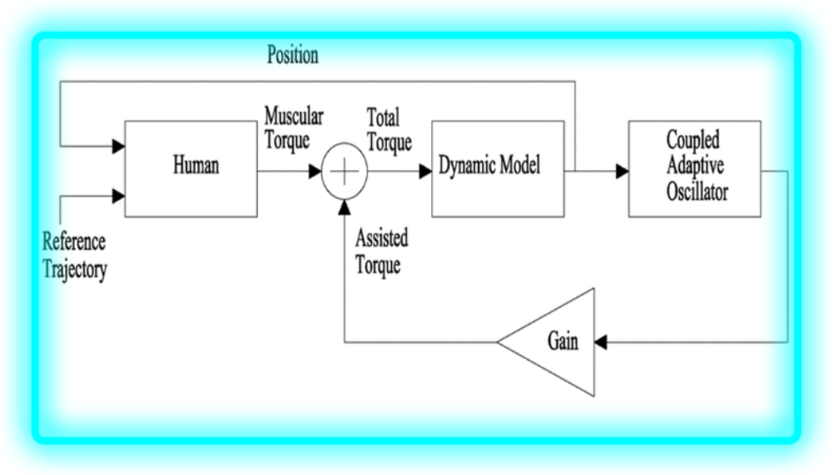
FUNCTIONAL BLOCK DIAGRAM

Slide 14
METHODOLOGY
Analysis of day to day problems faced and chose project to act as a solution.
Selection of Project and discussion with guide.
Collection of journals and resources regarding the project.
Rough Sketching and design in Solidworks.
Design analysis using Solidworks Simulation Addon.

Slide 15
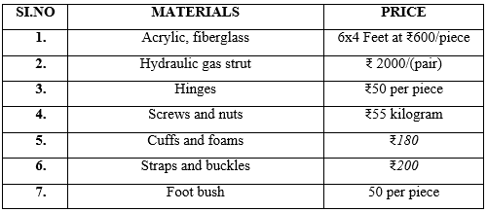
REQUIREMENT ANALYSIS

Slide 16
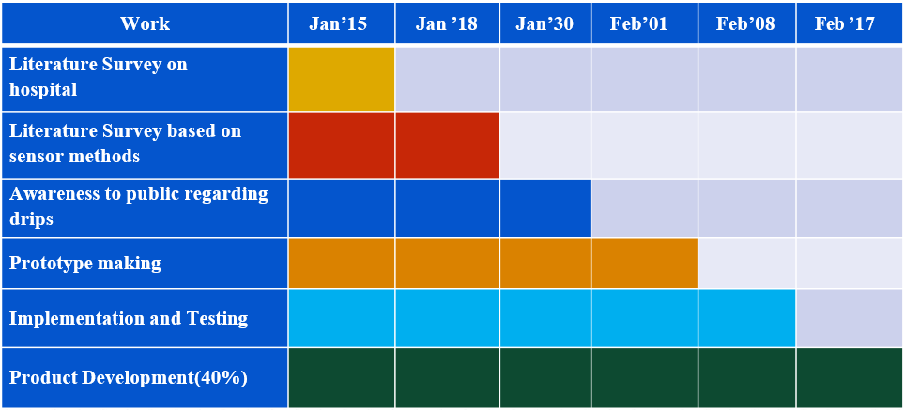
ACTION PLAN

Slide 17


REFERENCE
Eddison, Nicola; Gandy, Michael; Charlton, Paul; Chockalingam, Nachiappan (3 May 2022). "Prescription practices for rigid ankle-
foot orthoses among UK orthotists". Prosthetics & Orthotics International. Publish Ahead of Print. PMID 35511438. S2CID 248527667, 3 May 2022.
Waterval, Niels F. J.; Nollet, Frans; Harlaar, Jaap; Brehm, Merel- Anne. "Modifying ankle foot orthosis stiffness in patients with calf muscle weakness: gait responses on group and individual level". Journal of NeuroEngineering and Rehabilitation. 16 (1):
120. doi:10.1186/s12984-019-0600-2. ISSN 1743-0003. PMC
6798503. PMID 31623670, 17 October 2019.

Slide 18
REFERENCE
Eddison N, Chockalingam N."The effect of tuning ankle foot orthoses-footwear combination on the gait parameters of children with cerebral palsy". Prosthetics and Orthotics International. 37 (2): 95–107. doi:10.1177/0309364612450706.
PMID 22833518. S2CID 29917264, 2013.
Meadows B, Bowers RJ, Owen E. Hsu JD, Michael JW, Fisk JR (Eds.). Biomechanics of the hip, knee and ankle. AAOS Atlas of
Orthoses and Assistive Devices (in German) (4 Ed.). Philadelphia: Mosby Elsevier. pp. 299-309. ISBN 978-0-323-03931-4, 2008..

Slide 19

"THE SOUL BECOMES PRUDENT BY SITTING AND BEING QUIET."

